Slide 1
DevOps & Cloud Infrastructure: Orchestration
Jason Baker
Adjunct Instructor
Graduate Programs in Software
University of St. Thomas
St. Paul, MN

Slide 2
Agenda
Service discovery patterns
AWS Systems Manager Parameter Store
AWS Secrets Manager
AWS Cloud Map
Container orchestration
AWS ECS
AWS Fargate

Slide 3
Service Discovery
The process by which one service determines the location of another service.
How do we connect services together in dynamically deployed infrastructure?
Example: Web service needs to know the location of the database service.
This is one of the most critical challenges to solve in a distributed application architecture!

Slide 4
Service Discovery
A distributed application platform heavily leverages service discovery:
Potentially needs to track dozens or hundreds of services.
May need to support service versioning.
Route service requests based on infrastructure topology changes.
Container or instance failure, auto-scaling

Slide 5
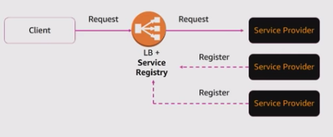
Service discovery patterns
Two general patterns:
Server-side service discovery
Application connections are proxied and discovery is abstracted away.
Applications just need to know proxy endpoint.

Slide 6
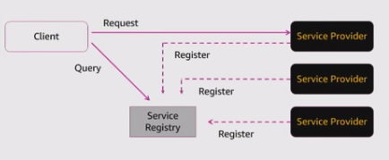
Service discovery patterns
Client-side service discovery
Applications connect directly to other services.
Clients communicate with a service registry.
Application clients handle load balancing.

Slide 7
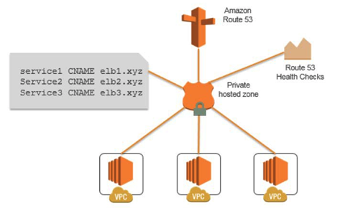
Service discovery methods
Traditionally we would hard-code service locations because infrastructure didn’t change often.
Domain Name Services
Discover the IP address of a system based on a name.
Not originally designed for dynamic infrastructure changes.

Slide 8
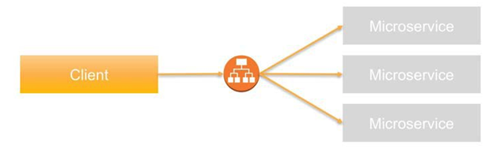
Service discovery methods
Application load balancer service discovery
Abstracts the location for a single service
Doesn't address how a service finds the load balancer endpoint.
Source: http://www.slideshare.net/scaganoff/service-discovery-with-consul

Slide 9
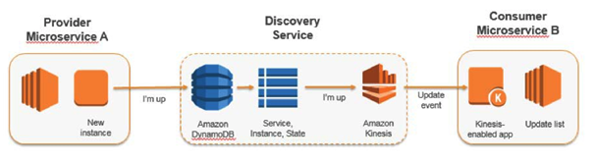
Service discovery methods
Store service information in distributed file systems and databases
Distributed data storage challenges (lock servers)

Slide 10
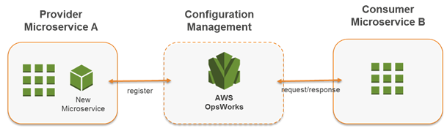
Service discovery methods
Use outputs from Infrastructure definition tools like CloudFormation to determine service location.
Problem: Tooling doesn’t update locations when infrastructure fails.

Slide 11
Service discovery methods
Dynamic service discovery platform

Slide 12
Service discovery solutions
Apache Zookeeper
Originally started as a project at Yahoo, now a part of Apache Foundation.
https://zookeeper.apache.org/
Etcd
Distributed consistent key-value store for shared configuration data.
Written in Go and maintained by CoreOS team.
https://github.com/coreos/etcd
Commonly used in container-based clusters (i.e., Kubernetes).
Consul
Service discovery system designed by HashiCorp.
Distributed key/value store.
Source: https://en.wikipedia.org/wiki/Apache_ZooKeeper

Slide 13
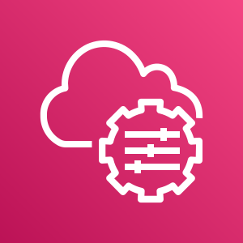
AWS Systems Manager Parameter Store
A key-value data store provided by AWS Systems Manager
Strings, StringList, SecureStrings
Standard: <10k parameters @ 4KB each (free)
Advanced: 10k+ parameters @ 8KB each ($)
Enable high throughput (1-1000/tps) ($)

Slide 14
AWS Systems Manager Parameter Store
# python get parameter example
import boto3
client = boto3.client('ssm')
Response = client.get_parameter(
Name='myparameter',
WithDecryption=False
)
# JSON response below
{
"Parameter": {
"Name": "myparameter",
"LastModifiedDate": 1520896963.519,
"Value": "secretpassword",
"Version": 2,
"Type": "String",
"ARN": "arn:aws:ssm:us-east-1:419462506938:parameter/myparameter"
}
}

Slide 15

AWS Secrets Manager
A key-value data store for managing sensitive data
API tokens, service passwords, encryption keys
Can store encrypted strings like Parameter Store
Key values may be versioned
Integrated with RDS, Redshift, DocumentDB, and others
Supports automated key rotation using Lambda
$0.40/secret per month

Slide 16
AWS Secrets Manager
# python get secret example
import boto3
client = boto3.client(secretsmanager')
Response = client.get_secret_value(
SecretId='company.financial.database',
VersionId='1.1'
)
# JSON response below (truncated for brevity)
{
"Name": "company.financial.database",
"VersionId": "289f1f291-0b36-4ca8-9dec-sdfsdf2e12fg12g",
"SecretString": "{\"Certificate\":\"MIIJoQIsdf823hjsdf7881923rhf8y8127hf8912hvf9812rhjhgfv1regty8912737qGSIb3DQEHBqCCA/WP+0epW+uvuFm1199DqTwpkwaEQQIgiiFtSgjnioCAggA\",\"Passphrase\":\"skjdf812jf9812hjf912ehfr\"}",
"VersionStages": [
"AWSCURRENT"
],
"CreatedDate": 1529431126.997,
"ARN": "arn:aws:secretsmanager:us-east-1:419462506938:secret: company.financial.database-VJ78GF"
}

Slide 17
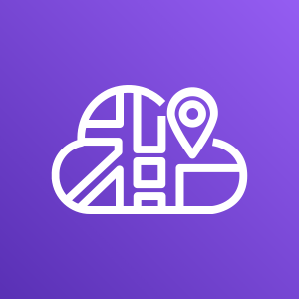
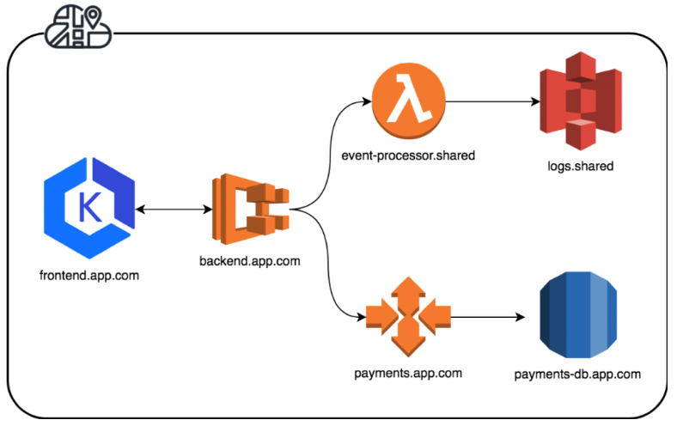
AWS Cloud Map
Managed service registry which tracks application components, locations, attributes, and health status.
Allows applications to query Cloud Map using SDK, API, or DNS

Slide 18
AWS Cloud Map
Define:
Namespace
logical name for grouping services
Configure instance discovery to use API or API + DNS
Service
Template for registering service instances
Specify IP routing (if using DNS)
Optionally define a health check
Define service instances
Attributes

Slide 19
AWS Cloud Map
Discover instances using DNS or DiscoverInstances API
# aws servicediscovery discover-instances --namespace-name myapp --service-name webservice
{
"Instances": [
{
"InstanceId": "endpoint",
"NamespaceName": "myapp",
"ServiceName": "webservice",
"HealthStatus": "UNKNOWN",
"Attributes": {
"url": "http://webservice.myapp.com/api/v1"
}
}
]
}

Slide 20
Orchestration
A set of processes which control the lifecycle of infrastructure resources.
Like CRUD operations on compute, storage, and network resources.
AWS Console, EC2 Autoscaling
CloudFormation, Elastic Beanstalk, Ansible

Slide 21
Container orchestration
Container orchestration needs to:
Schedule containers to run on computing instances.
Handle scenarios where a container or container host fails.
Distribute requests across sets of containers.
Deploy container image updates.
Provide a service discovery mechanism so services running in containers can find other services.

Slide 22
Container orchestration
What container orchestration looks like:
Define containers and let the orchestration platform figure out the best location to run the containers.
The orchestration platform monitors state of containers and automatically handles topology changes.
The orchestration platform automatically sets up networking so that services in containers can communicate.

Slide 23
Kubernetes
Open-source container orchestration platform designed by Google.
Name originates from Greek, meaning “helmsman” or “pilot”.
Based on key technical principles Googles uses to scale its global platform.
Each K8S cluster contains a master instance and multiple nodes, each running a Kubelet (agent) and engine (Docker).

Slide 24
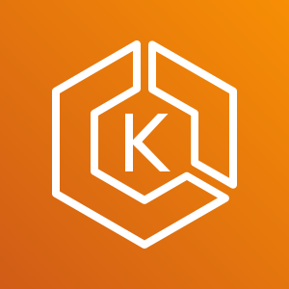
AWS EKS
Elastic Container Service for Kubernetes

Slide 25
Docker Swarm
An integrated cluster orchestration service built into the Docker engine.
Manages containers running on a cluster of nodes (EC2 instances).
Uses two types of nodes: managers and workers.
Node type is defined during deployment.
Follows a declarative approach: define the state of services in an application stack and Docker will try to achieve that desired state.

Slide 26

AWS Elastic Container Service (ECS)
A Docker container management solution that runs on top of EC2 or Fargate.
AWS deploys managed infrastructure to support your containers.
No need to build AMIs or configure servers.
AWS automatically deploys your containers to the managed hosts and maintains a desired configuration state.
Define configuration in CloudFormation and JSON files.
AWS EC2 Container Registry (ECR)
A private Docker image repository (like Docker Hub).

Slide 27
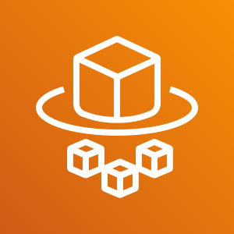
Fargate
Run containers as a fundamental compute primitive.
We can launch and manage containers like EC2 instances.
Fully managed compute infrastructure: we have no access to the host servers.
Default infrastructure for running containers in ECS.
Integrates with other services – VPC, ELB, IAM, Cloudwatch, Cloudformation, etc.

Slide 28
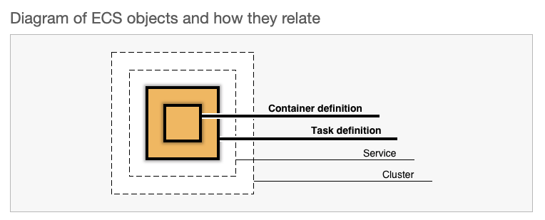
Fargate components

Slide 29
Fargate components
Task definition
A JSON file which describe how to configure containers (up to 10) that form your application.
Container image, exposed ports, data volumes, cpu/memory.
A task represents the instantiation of a task definition in a computing cluster.
We can run multiple tasks in a cluster, each with it’s own isolated compute and networking environment.
The ECS Task Scheduler is responsible for placing tasks within the cluster.

Slide 30
Fargate components
Service
A service represents a specified number of task definitions running simultaneously in a cluster.
ECS will attempt to maintain a desired state despite task failures and topology changes.
Supports running multiple tasks behind an elastic load balancer for increased resiliency.
Integration with Route53 for service discovery.

Slide 31
Fargate components
Cluster: a group of computing resources that host containers
Fully managed Fargate compute infrastructure
Can also use EC2 instances
Each compute node runs an ECS agent which manages tasks

Slide 32
Fargate components

Slide 33
Creating a cluster
Three cluster options:
Networking only (Fargate)
EC2 Linux + Networking
EC2 Windows + Networking
Cluster only has a name property
{ "Type" : "AWS::ECS::Cluster",
"Properties" : { "ClusterName" : String }
}

Slide 34
Creating a task definition
Task definition parameters describe how to run containers:
Family: the name assigned to the task definition
Networking mode
Fargate only supports a networking mode called awsvpc where each task has a dedicated elastic network interface.
CPU/ memory to allocate to task
CPU increments: 256 (.25 vCPU) – 4096 (4 vCPU)
Memory increments: 0.5GB-30GB
IAM role tasks can use (like EC2 instance profile)
Container definitions: describes one or more containers to run in a task
Docker image to use
Pull from Docker Hub, ECR, or Private Docker repository

Slide 35
Creating a task definition
CPU/ memory to allocate to container
Logging configuration
Fargate uses the awslogs driver which sends logs to AWS CloudWatch Logs.
Command container should run when it starts
Task storage volumes
10GB of ephemeral Docker layer storage
4 GB of volume mount storage which may be shared

Slide 36
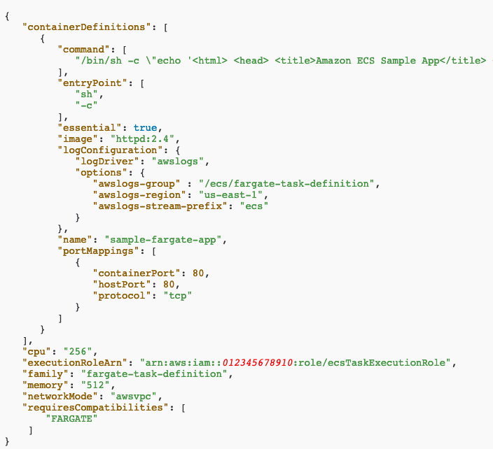
Creating a task definition

Slide 37
Architecting app on ECS
Question: Multiple containers in the same task definition OR deploy containers in multiple task definitions?
Single task definition:
Containers share common lifecycle
Containers reference each other on localhost port
Containers share resources or data volumes
Separate task definitions:
Allow you to scale and manage containers separately

Slide 38
Task networking
Fargate uses the awsvpc network mode
Every task gets an elastic network interface in a VPC
Similar to an EC2 instance
Primary private IP addresss and internal DNS hostname
May assign a public IP address
Needs to use a NAT gateway to access Internet from private subnet
Ability to associate security groups
Ability to use as a target for elastic load balancer

Slide 39
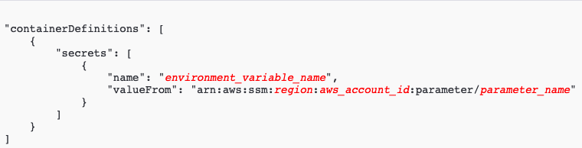
Secrets
Tasks may need access to secrets like API tokens, passwords, and security keys.
Inject sensitive data into containers using AWS Secrets Manager or Parameter Store.

Slide 40
Creating a service
The service definition describes:
How many tasks to run simultaneously
How to deploy those tasks
How to distribute requests across tasks
How to find tasks
Deployment types:
Rolling update
Blue/Green deployment (CodeDeploy)
External: custom deployment managed by API

Slide 41
Creating a service
Load balancing
Containers that are launched in a single task definition are placed on the same host.
A service launching multiple tasks will deploy containers on separate hosts in multiple availability zones.
Use an application or network elastic load balancer to distribute requests across tasks.
A server can only have 1 associated load balancer.
Load balancer uses the task elastic IP in the target group

Slide 42
Creating a service
Auto Scaling: ECS can automatically scale the number of tasks up or down
Specify desired number of tasks
Create a policy which scales tasks based on a CloudWatch metric (CPU%)
Service discovery
ECS tightly integrated with AWS Cloud Map

Slide 43

Fargate Hands-on
Launch a basic Fargate cluster:
https://seis665.s3.amazonaws.com/pets-basic-template.json
Launch a more resilient Fargate cluster leveraging service discovery:
https://seis665.s3.amazonaws.com/pets-discovery-template.json
Remember to delete the CloudFormation stack!

